Slide 1

DATensify: A Paradigm Shift in AI-Driven Predictive Maintenance for Distribution Automation Terminals in Smart Grids
Course: CECS 574 Topics in Distributed Computing
Prof. Pooria Yaghini
Team Name: Mission 574
Varun Bhuva
Bhargav Diyora
Meet Patel

Slide 2
Index
Introduction to DATensify
Market Analysis
Implementation phases
Edge Computing Integration
AI Techniques
Impact of DATensify
Conclusion

Slide 3
Introduction to DATensify
Market trends favor adaptive maintenance in smart grids.
DATensify innovates with dynamic learning and data fusion for DAT maintenance.
DATensify delivers real-world grid reliability enhancements.
DATensify's scalable framework drives AI-driven grid maintenance.

Slide 4
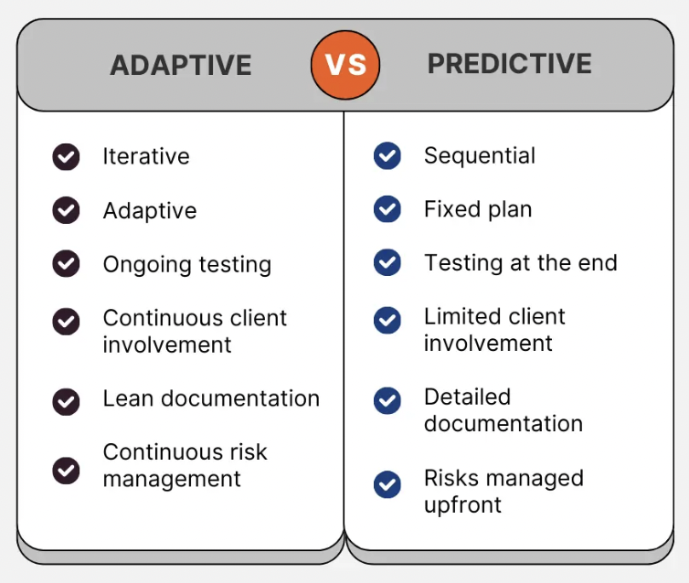
Market Analysis
Static threshold-based methods fall short in dynamic grids, highlighting the need for adaptive maintenance.
Adaptive maintenance strategies offer flexibility and responsiveness crucial for modern grid environments.

Slide 5
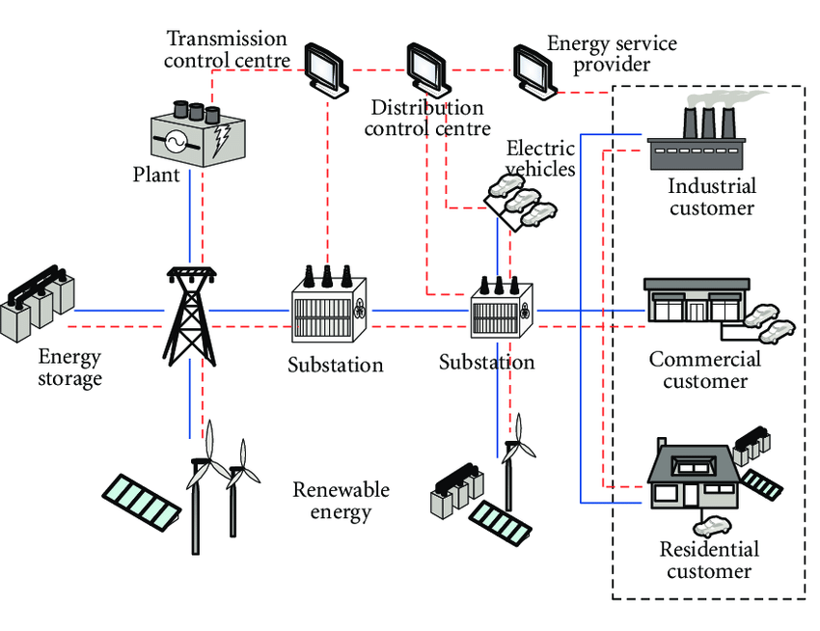
Inspiration for DATensify
The analysis of existing maintenance methods inspired the development of DATensify's dynamic and intelligent framework.
The growing demand for adaptable maintenance solutions in smart grids drove the creation of DATensify.

Slide 6
Implementation phases
Data Collection
Validation and Testing
Data Cleaning
Model Training
Data Integration
Feature Extraction

Slide 7
Dynamic Learning Algorithms
DATensify utilizes dynamic learning algorithms like ensemble methods and online learning.
These algorithms continuously improve predictive models with incoming data.
Ensemble methods combine multiple models to enhance accuracy and robustness.
Online learning enables real-time updates and adaptation to changing data patterns.
The iterative nature of dynamic learning ensures models evolve to capture evolving trends and anomalies.

Slide 8
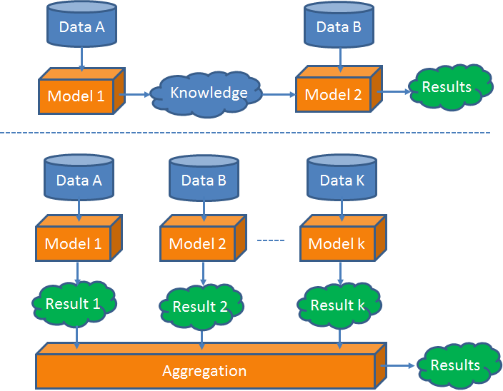
Multimodal Data Fusion
DATensify integrates diverse data sources like electrical measurements, environmental data, and operational logs.
This fusion creates a comprehensive view of DAT health and performance, capturing nuanced behaviors and correlations.
The holistic data representation enhances predictive maintenance analysis and decision-making in smart grid environments.

Slide 9
Reinforcement Lerning
RL algorithms in DATensify adaptively learn optimal maintenance policies, optimizing resource allocation and minimizing downtime based on real-time feedback.
By continuously interacting with the environment, DATensify's RL agents dynamically adjust maintenance schedules, ensuring proactive and cost-effective strategies tailored to system dynamics.
The adaptive nature of RL in DATensify enables it to handle evolving grid conditions, responding to anomalies and failure patterns in real time for efficient maintenance interventions.
DATensify's RL framework integrates feedback loops, learning from past experiences to make informed decisions, improving maintenance efficiency and grid reliability over time.

Slide 10
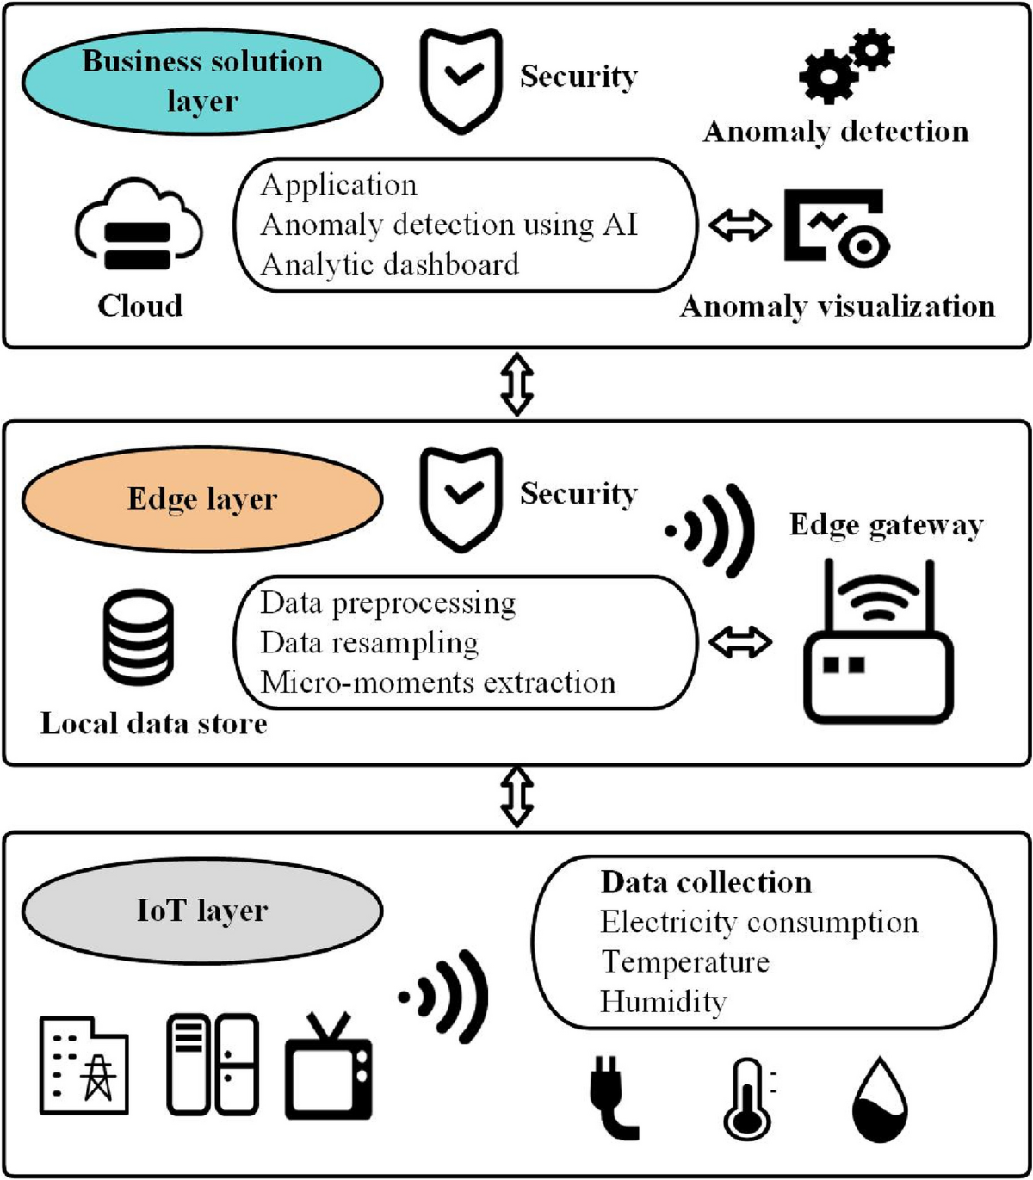
Edge Computing Integration
Edge computing in DATensify ensures real-time analysis by processing data closer to its source, reducing latency and enhancing system responsiveness.
By leveraging edge computing infrastructure, DATensify optimizes data processing, leading to faster insights and more agile decision-making in predictive maintenance for Distribution Automation Terminals.
Notes:
d

Slide 11
Explainable AI Techniques
Explore the inner workings of DATensify's explainable AI techniques, unveiling transparent insights into maintenance decision-making for DATs.
Gain a deep understanding of how DATensify provides clear rationales behind its recommended maintenance actions, fostering trust and collaboration among maintenance teams.
Uncover the black box of AI with DATensify's explainable AI techniques, empowering stakeholders to comprehend and validate maintenance decisions with clarity.

Slide 12
Outcomes of DATensify
DATensify's dynamic adaptability ensures real-time adjustments, enhancing grid responsiveness and reliability.
With accurate predictions and optimized maintenance schedules, DATensify minimizes downtime and maximizes operational efficiency.

Slide 13
Transparent Explanations
Transparent explanations in DATensify build trust and understanding among maintenance teams.
Clear insights empower personnel to optimize strategies and make informed decisions.
DATensify's explainable AI interface provides detailed maintenance recommendations.
Transparent AI bridges the gap between insights and actionable maintenance actions.
Transparent explanations in DATensify promote collaboration and drive sustainable energy management.

Slide 14
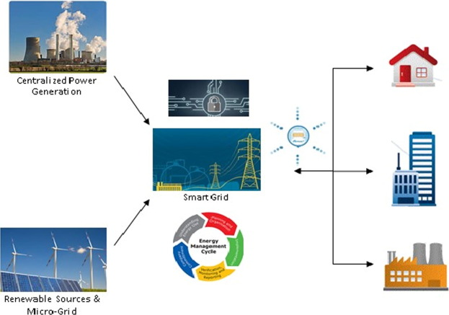
Impact of DATensify
DATensify enhances grid reliability, operational efficiency, and sustainability, delivering significant benefits to stakeholders in the energy sector.
Improved grid performance and reliability are tangible outcomes of implementing DATensify, resulting in optimized operations and reduced downtime.
Visual representations showcase DATensify's transformative impact, depicting enhanced grid stability and sustainable energy management practices.

Slide 15
The Journey of DATensify
Pilot Deployment
Future Directions
Initial Conceptualization
Full-Scale Implementation
Refinement and Optimization
Development and Prototyping
Industry Recognition

Slide 16
Conclusion
In conclusion, DATensify represents a groundbreaking leap in AI-driven predictive maintenance, revolutionizing grid reliability and operational efficiency.
The journey of DATensify showcases a commitment to innovation, collaboration, and sustainable energy management practices.
DATensify's transparent AI and dynamic adaptability empower stakeholders to make informed decisions and drive continuous improvement.
As we look ahead, DATensify's impact will continue to shape the future of predictive maintenance and contribute to a smarter, greener energy infrastructure.
Thank you for joining us on this transformative journey with DATensify, where every milestone brings us closer to a more resilient and intelligent grid ecosystem.

Slide 17
References
L. Han, Z. Xing, S. Wang, D. Qiao, Y. Xie and P. Sun, "Research on Intelligent Operation and Maintenance System of Power Distribution Automation Terminal under Computer Big Data," 2023
DL/T 1406-2015 Technical guide for distribution automation (Beijing: Standards Press of China)
Pan, Z., Li, H., Wang, J., & Peng, G. (2021, January 1). An Operation and Maintenance Training Platform for Distribution Terminal Unit.
Jung K-H, Kim H, Ko Y (1993) Network reconﬁguration algorithm for auto-mated distribution systems based on artiﬁcial intelligence approach. IEEE Trans Power Delivery 8(4):1933–1941
Jafari M et al (2022) A survey on deep learning role in distribution automation system: a New Collaborative Learning-to-learning (L2L) Concept. IEEE Access 10:81220–81238

Slide 18

Thank you !

